Slide 1
Booting of Computer System
Telerik Software Academy
academy.telerik.com
Inside Windows Boot Process
Borislav Varadinov
Marian Marinov
System Administrator
CEO of 1H Ltd.
bobi@itp.bg
mm@1h.com

Slide 2


Table of Contents
Windows Installation Program
MBR Boot Code
Volume Boot-Sector Code
Windows Boot Manager
Windows Loader
Windows Boot Process Components

Slide 3
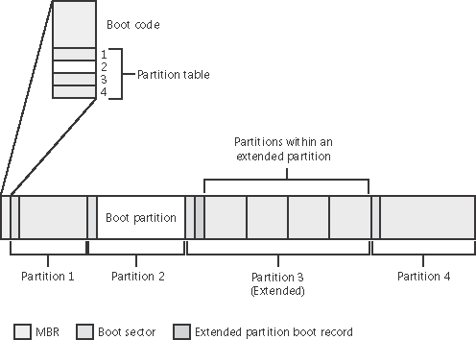
Windows Installation Program
The Windows operating system installation program writes the MBR Boot Code and the Volume (Partition) boot sector to the bootable partition.

Slide 4
Windows MBR Boot code
MBR Boot Code go through a similar process as BIOS of reading and transferring control.
Scans the primary partition table until it locates a partition containing a flag (Active)
When finds at least one such flag, it reads the first sector from the flagged partition into memory and transfers control to code within the partition
This type of partition is called a system partition

Slide 5
Volume Boot-Sector Code
The primary role of the volume boot-sector code is to read and load the Bootmgr file from the root directory of the volume.
Contains just enough read-only file system code to accomplish this task
Loads Bootmgr into memory and transfers control to Bootmgr’s entry point
If cannot find Bootmgr in the volume’s root directory, it displays the error message:
“BOOTMGR is missing”

Slide 6
Windows Boot Manager
Goodbye NTLDR and Boot.ini
NTLDR is the boot loader for all NT successors up to and including Windows XP/2003
The startup process of Vista and all successors is different from previous versions
Windows Boot Manger
OS Loader

Slide 7
Boot Manager
The primary role of the Windows Boot Manager is to execute the OS Loader (Winload.exe)
Reads the Boot Configuration Data (BCD) file from the \Boot directory using built-in file system code.
Presents the user with the boot-selection menu
Loads and execute OS Loader program or Volume Boot Record Code

Slide 8
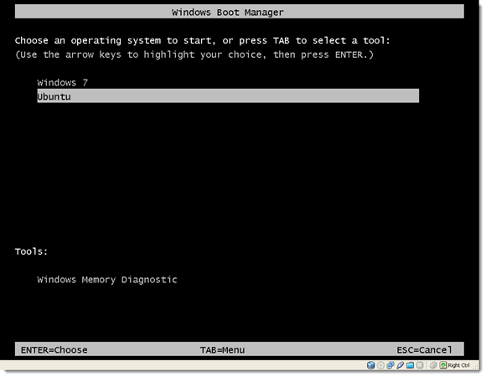
Boot Manger Screen

Slide 9
Windows Loader
The Windows OS Loader (WINLOAD.exe) is an operating system loader which loads the Windows operating system kernel
Loads Ntoskrnl.exe
Loads other boot start binary image files
Prepares CPU registers for the execution of Ntoskrnl.exe.
Finally calls the main function in Ntoskrnl.exe (KiSystemStartup)
Notes:
Finally calls the main function in Ntoskrnl.exe (KiSystemStartup) to perform the rest of the system initialization.

Slide 10
Boot Process Overview
BIOS
MBR Boot Code
Volume Boot Code
Windows Boot Manager
Windows Boot Manager
Winload
Ntoskrnl

Slide 11
Boot Process Components
Component | Responsibilities
Master Boot Record | Reads and loads the volume boot record (VBR)
Volume boot record | Understands the file system on the partition and locates Bootmgr by name, loading it into Memory
Bootmgr | Reads the Boot Configuration Database (BCD), presents boot menu, and allows execution of preboot programs such as the Memory Test application (Memtest.exe).
Winload.exe | Loads Ntoskrnl.exe and Hal.dll and bootstart device drivers.
Winresume.exe | If resuming after a hibernation state, resumes from the hibernation file (Hiberfil.sys) instead of typical Windows loading.

Slide 12
Boot Process Components (2)
Component | Responsibilities
Ntoskrnl.exe | Initializes executive subsystems and boot and system-start device drivers, prepares the system for running native applications, and runs Smss.exe.
Hal.dll | Kernel-mode DLL that interfaces Ntoskrnl and drivers to the hardware. It also acts as a driver for the motherboard itself, supporting soldered components that are not otherwise managed by another driver.

Slide 13
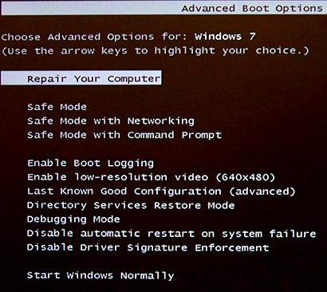
The magic button F8?
Last Known Good (LKG)
Safe Mode
WinRE

Slide 14
Windows Boot Process
http://academy.telerik.com

Slide 15




Free Trainings @ Telerik Academy
"Web Design with HTML 5, CSS 3 and JavaScript" course @ Telerik Academy
html5course.telerik.com
Telerik Software Academy
academy.telerik.com
Telerik Academy @ Facebook
facebook.com/TelerikAcademy
Telerik Software Academy Forums
forums.academy.telerik.com

